Slide 1
Software Testing & Quality
(02)-等价类测试
陈振宇
南京大学软件学院
http://software.nju.edu.cn/zychen

Slide 2
内容
等价类的基本思想
划分等价类的规则
等价类划分法测试用例设计
等价类测试的分类
边界值分析
边界值选取
边界值组合
讨论

Slide 3
等价类测试
把所有可能的输入数据,即程序的输入域划分成若干部分（子集）,然后从每一个子集中选取少数具有代表性的数据作为测试用例。
黑盒测试用例设计方法。
Equivalence Class testing
Domain testing
Partition testing

Slide 4
等价类测试的优点
适用性广
  Unit
  Integration
  System
易于使用：预备知识要求低
使用灵活：根据实际应用场景易于调整

Slide 5
测试基本思想
Test Data
Test
Failure mapping
function
Software
Fault in Software

Slide 6
等价类划分
等价类是指某个中,各个输入数据对于揭露程序中的错误都是等效的。
整个集合I, 划分为 I₁,I₂,…,I_{n}
  无冗余：两两互补相交
  完备性：所有I_{i}并集为整个集合I
讨论：
  合理性？
  不合理性？

Slide 7
两类等价类
有效等价类
  是指对于程序的规格说明来说是合理的、有意义的输入数据构成的集合。
  利用有效等价类可检验程序是否实现了规格说明中所规定的功能和性能。
无效等价类
  无效等价类指对程序的规格说明是不合理的或无意义的输入数据所构成的集合。
  无效等价类至少应有一个，也可能有多个。

Slide 8
如何划分等价类
划分的内容：
  输入域
  执行域
  输出域
划分的依据：
  类型特性
  规格需求
  行为特性
  输出需求

Slide 9
等价类划分方法1
如果输入条件规定了取值范围，可定义一个有效等价类和两个无效等价类。
例： 输入值是学生成绩，范围是0～100
有效等价类：①0≤成绩≤100
无效等价类：①成绩<0，②成绩>100

Slide 10
等价类划分方法2
如规定了输入数据的一组值，且程序对不同输入值做不同处理，则每个允许的输入值是一个有效等价类，并有一个无效等价类(所有不允许的输入值的集合)。
例：输入条件说明学历可为:专科、本科、硕士、博士四种之一
有效等价类：①专科、②本科、③硕士、④博士
无效等价类：①其它任何学历

Slide 11
等价类划分方法3
如果规定了输入数据的个数，则类似地可以划分出一个有效等价类和两个无效等价类。
例：一个学生每学期只能选修1～3门课
有效等价类：①选修1～3门
无效等价类：①不选 或 ②选修超过3门

Slide 12
等价类划分方法4
如果规定了输入数据必须遵循的规则，可确定一个有效等价类（符合规则）和若干个无效等价类（从不同角度违反规则)。
例：校内电话号码拨外线为9开头
有效等价类：① 9＋外线号码
无效等价类：①非9开头＋外线号码
② 9＋非外线号码，…

Slide 13
输入域的两种建模方法
基于接口/输入的建模方法
  Develops characteristics directly from individual input parameters
  Simplest application
  Can be partially automated in some situations
基于功能的建模方法
  Develops characteristics from a behavioral view of the program under test
  Harder to develop—requires more design effort
  May result in better tests, or fewer tests that are as effective

Slide 14
基于接口的建模方法
Mechanically consider each parameter in isolation
This is an easy modeling technique and relies mostly on syntax
Some domain and semantic information won’t be used
  Could lead to an incomplete IDM
Ignores relationships among parameters
Consider TriTyp from Chapter 3
Three int parameters
IDM for each parameter is identical
Reasonable characteristic : Relation of side with zero

Slide 15
三角形程序例子
TriTyp, from Chapter 3, had one testable function and three integer inputs
First Characterization of TriTyp’s Inputs
Characteristic | b₁ | b₂ | b₃
q₁ = “Relation of Side 1 to 0” | greater than 0 | equal to 0 | less than 0
q₂ = “Relation of Side 2 to 0” | greater than 0 | equal to 0 | less than 0
q₃ = “Relation of Side 3 to 0” | greater than 0 | equal to 0 | less than 0
A maximum of 3*3*3 = 27 tests
Some triangles are valid, some are invalid
Refining the characterization can lead to more tests …

Slide 16
三角形程序例子
Second Characterization of TriTyp’s Inputs
Characteristic | b₁ | b₂ | b₃ | b₄
q₁ = “Refinement of q₁” | greater than 1 | equal to 1 | equal to 0 | less than 0
q₂ = “Refinement of q₂” | greater than 1 | equal to 1 | equal to 0 | less than 0
q₃ = “Refinement of q₃” | greater than 1 | equal to 1 | equal to 0 | less than 0
A maximum of 4*4*4 = 64 tests
This is only complete because the inputs are integers (0 . . 1)
Possible values for partition q₁
Characteristic | b₁ | b₂ | b₃ | b₄
Side1 | 5 | 1 | 0 | -5
2
-1
Test boundary conditions
© Ammann & Offutt

Slide 17
基于功能的建模方法
Identify characteristics that correspond to the intended functionality
Requires more design effort from tester
Can incorporate domain and semantic knowledge
Can use relationships among parameters
Modeling can be based on requirements, not implementation
The same parameter may appear in multiple characteristics, so it’s harder to translate values to test cases
Consider TriTyp again
The three parameters represent a triangle
IDM can combine all parameters
Reasonable characteristic : Type of triangle

Slide 18
三角形程序例子
First two characterizations are based on syntax–parameters and their type
A semantic level characterization could use the fact that the three integers represent a triangle
Geometric Characterization of TriTyp’s Inputs
Characteristic | b₁ | b₂ | b₃ | b₄
q₁ = “Geometric Classification” | scalene | isosceles | equilateral | invalid
Oops … something’s fishy … equilateral is also isosceles !
We need to refine the example to make characteristics valid
Correct Geometric Characterization of TriTyp’s Inputs
Characteristic | b₁ | b₂ | b₃ | b₄
q₁ = “Geometric Classification” | scalene | isosceles, not equilateral | equilateral | invalid

Slide 19
三角形程序例子
Values for this partitioning can be chosen as
Possible values for geometric partition q₁
Characteristic | b₁ | b₂ | b₃ | b₄
Triangle | (4, 5, 6) | (3, 3, 4) | (3, 3, 3) | (3, 4, 8)

Slide 20
三角形程序例子
A different approach would be to break the geometric characterization into four separate characteristics
Four Characteristics for TriTyp
Characteristic | b₁ | b₂
q₁ = “Scalene” | True | False
q₂ = “Isosceles” | True | False
q₃ = “Equilateral” | True | False
q₄ = “Valid” | True | False
Use constraints to ensure that
  Equilateral = True implies Isosceles = True
  Valid = False implies Scalene = Isosceles = Equilateral = False

Slide 21
等价类测试用例设计
(1) 对每个输入或外部条件进行等价类划分，形成等价类表，为每一等价类规定一个唯一的编号；
(2)设计一测试用例，使其尽可能多地覆盖尚未覆盖的有效等价类，重复这一步骤，直到所有有效等价类均被测试用例所覆盖；
(3)设计一新测试用例，使其只覆盖一个无效等价类，重复这一步骤直到所有无效等价类均被覆盖；

Slide 22
示例1：报表日期
设某公司要打印2001～2005年的报表，其中报表日期为6位数字组成，其中，前4位为年份，后两位为月份。

Slide 23
第一步：划分等价类
输入及外部条件 | 有效等价类 | 无效等价类
报表日期的 类型及长度 | 6位数字字符① | 有非数字字符 ④ 少于6个数字字符 ⑤ 多于6个数字字符 ⑥
年份范围 | 在2001～2005之间② | 小于2001 ⑦ 大于2005 ⑧
月份范围 | 在1～12之间③ | 小于1 ⑨ 大于12 ⑩

Slide 24
第二步：为有效等价类设计测试用例
对表中编号为①②③的3个有效等价类用一个测试用例覆盖：
测试数据 | 期望结果 | 覆盖范围
200105 | 输入有效 | 等价类①②③

Slide 25
第三步：为每一个无效等价类至少设计一个测试用例
测试数据 | 期望结果 | 覆盖范围
001MAY | 输入无效 | 等价类④
20015 | 输入无效 | 等价类⑤
2001001 | 输入无效 | 等价类⑥
20000 | 输入无效 | 等价类⑦
20080 | 输入无效 | 等价类⑧
200100 | 输入无效 | 等价类⑨
200113 | 输入无效 | 等价类⑩

Slide 26
示例2 电话号码
城市的电话号码由两部分组成。这两部分的名称和内容分别是：
  地区码：以0开头的三位或者四位数字（包括0）；
  电话号码：以非0、非1开头的七位或者八位数字。
假定被调试的程序能接受一切符合上述规定的电话号码，拒绝所有不符合规定的号码，就可用等价分类法来设计它的测试用例。

Slide 27
划分等价类并编号
输入数据 | 有效等价类 | 无效等价类
地区码 | 以0开头的3位数串 以0开头的4位数串 | 以0开头的含有非数字字符的串 以0开头的小于3位的数串 以0开头的大于4位的数串 以非0开头的数串
电话号码 | 以非0、非1开头的7位数串 以非0、非1开头的8位数串 | 以0开头的数串 以1开头的数串 以非0、非1开头的含有非法字符7或者8位数串 以非0、非1开头的小于7位数串 以非0、非1开头的大于8位数串

Slide 28
为有效等价类设计测试用例
测试数据 | 期望结果 | 覆盖范围
010 23145678 | 显示有效输入 | （1）、（8）
023 2234567 | 显示有效输入 | （1）、（7）
0851 3456789 | 显示有效输入 | （2）、（7）
0851 23145678 | 显示有效输入 | （2）、（8）

Slide 29
为每一个无效等价类至少设计一个测试用例
测试数据 | 期望结果 | 覆盖范围
0a34 23456789 | 显示无效输入 | （3）
05 23456789 | 显示无效输入 | （4）
01234 23456789 | 显示无效输入 | （5）
2341 23456789 | 显示无效输入 | （6）
028 01234567 | 显示无效输入 | （9）
028 12345678 | 显示无效输入 | （10）
028 qw123456 | 显示无效输入 | （11）
028 623456 | 显示无效输入 | （12）
028 886234569 | 显示无效输入 | （13）

Slide 30
等价类测试的分类
单缺陷与多缺陷假设产生弱等价类与强等价类测试之分
是否进行无效数据的处理产生健壮与一般等价类测试之分

Slide 31
弱等价类测试
Assumes the ‘single fault’ or “independence of input variables.”
  e.g. If there are 2 input variables, these input variables are independent of each other.
Partition the test cases of each input variable separately into different equivalent classes.
Choose the test case from each of the equivalence classes for each input variable independently of the other input variable

Slide 32
弱等价类测试示例
Assume the equivalence partitioning of input X is: 1 to 10; 11 to 20, 21 to 30
and the equivalence partitioning of input Y is: 1 to 5; 6 to 10; 11;15; and 16 to 20
X
We have covered everyone
of the 3 equivalence classes
for input X.
30
20
For ( x, y )
we have:
(24, 2)
(15, 8 )
( 4, 13)
(23, 17)
10
1
Y
1
5
10
15
20
General rule for # of test cases?
What do you think?
# of partitions of the largest set?
We have covered each of the 4 equivalence classes for input Y.

Slide 33
强等价类测试
This is the same as the weak normal equivalence testing except for
“multiple fault assumption”
or
“dependence among the inputs”
All the combinations of equivalence classes of the variables must be included.

Slide 34
强等价类测试示例
Assume the equivalence partitioning of input X is: 1 to 10; 11 to 20, 21 to 30
and the equivalence partitioning of input Y is: 1 to 5; 6 to 10; 11;15; and 16 to 20
X
30
We have covered everyone
of the 3 x 4 Cartesian product of equivalence
classes
20
10
1
Y
1
5
10
15
20
General rule for # of test cases?
What do you think?

Slide 35
弱健壮性等价类测试
Up to now we have only considered partitioning the valid input space.
“Weak robust” is similar to “weak normal” equivalence test except that the invalid input variables are now considered.
A note about considering invalid input is that there may not
be any definition “specified” for the various, different invalid
inputs - - - making definition of the output for these invalid
inputs a bit difficult at times. (but fertile ground for testing)

Slide 36
弱健壮性等价类测试示例
Assume the equivalence partitioning of input X is 1 to 10; 11 to 20, 21 to 30
and the equivalence partitioning of input Y is 1 to 5; 6 to 10; 11;15; and 16 to 20
X
30
We have covered everyone of the 5 equivalence classes for input X.
20
10
1
Y
1
5
10
15
20
We have covered each of the 6 equivalence classes for input Y.

Slide 37
强健壮性等价类测试
Does not assume “single fault” - - - assumes dependency of input variables
“Strong robust” is similar to “strong normal” equivalence test except that the invalid input variables are now considered.

Slide 38
强健壮性等价类测试示例
Assume the equivalence partitioning of input X is: 1 to 10; 11 to 20, 21 to 30
and the equivalence partitioning of input Y is: 1 to 5; 6 to 10; 11;15; and 16 to 20
X
30
We have covered everyone
of the 5 x 6 Cartesian product of equivalence
classes (including invalid
inputs)
20
10
1
Y
1
5
10
15
20

Slide 39
示例3：NextDate
NextDate 函数包含三个变量 month、day和year，函数的输出为输入日期后一天的日期。 例如，输入为1989年5月16日，则函数的输出为1989年5月17日。 要求输入变量 month、 day和year均为整数值，并且满足下列条件，也就是有效等价类：
1 ≤month≤12
1≤day≤31
1900≤year≤2012

Slide 40
示例3：NextDate
若条件（1）~（3）中任何一个条件失效，则 NextDate 函数都会产生一个输出，指明相应的变量超出取值范围，比如 “month 的值不在 1-12 范围当中”。显然还存在着大量的 year、month、day 的无效组合，我们可以给出下列无效等价类：
  month<1
  month>12
  day<1
  day>31
  year<1900
  year>2012

Slide 41
边界值分析
边界值分析法就是对输入/内部/输出的边界值进行测试的一种黑盒测试方法。
通常边界值分析法是作为对等价类划分法的补充，这种情况下，其测试用例来自等价类的边界。
边界值分析不是从某等价类中随便挑一个作为代表，而是使这个等价类的每个边界都要作为测试条件。

Slide 42
边界值分析原理
错误容易出现极值边缘
  计数器通常多计/少计一次
  数值点下标0/1， n/n+1
  >=, >, <=,<
  +1,-1
  ++,--
Min,Min+,Nom,Max-,Max
Min-,Min,Min+,Nom,Max-,Max, Max+

Slide 43
整数
6位正整数
  Test cases :
    Class arbitrary value: X1 = 123123
    Class boundary value: X2 = 12345
    Class boundary value: X3 = 1234567
    Class boundary value: X4 = 1
    Class boundary value: X5 = 0
    Class invalid value: X6 = -123123
    Class invalid value: X7 = asdasd
    Others?
    Class invalid value: X8 = 000123
    X9 = asd123
    X10 = Empty

Slide 44
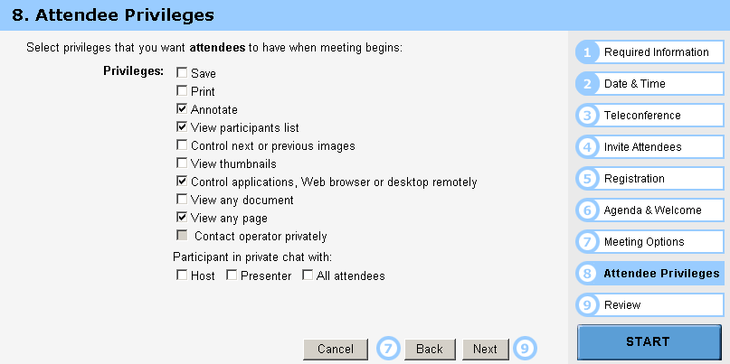
多选框
Test cases :
  Class arbitrary value: Random select some options
  Class boundary value: Select all options
  Class boundary value: Select none option
  Class boundary value: Select 1 option

Slide 45
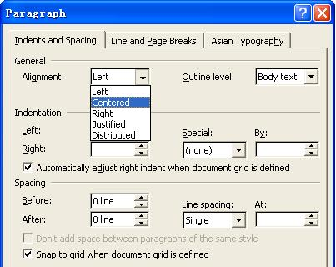
选择框

Slide 46
数据结构
Limits on input data - size, type
Limits on output data - size, type
Look for limits such as
  First-1/Last+1
  Start-1/Finish+1
  Min-1/max+1
  Less than empty/ more than full
  just Over/Just Under
  etc
Don’t hesitate to choose data outside boundaries, even when it seems absurd
Notes:
Absurd：荒谬的，违背常理的

Slide 47
数组
The array b has 10 elements.
i = x + 3;
IF b[i] <=5 THEN ,,,
ELSE …
We need three predicates:
b[x + 3] <= 5 – the original predicate
x + 3 >= 1 – not below lower bound
x + 3 >= 10 – not above upper bound

Slide 48
其它类型
  Numeric
  Character
  Position
  Quantity
  Speed
  Location
  Size
First/last
Min/Max
Star/Finish
Empty/Full
Slower/Faster
Largest/Smallest
Over/Under
Shortest/Longest
… …

Slide 49
边界值选取小结1
如果输入条件规定了值的范围,则应取刚达到这个范围的边界的值,以及刚刚超越这个范围边界的值作为测试输入数据。
例如，如果程序的规格说明中规定："重量在10公斤至50公斤范围内的邮件，其邮费计算公式为……"。作为测试用例，我们应取10及50，还应取10.01,49.99,9.99及50.01等。

Slide 50
边界值选取小结2
如果输入条件规定了值的个数,则用最大个数,最小个数,比最小个数少一,比最大个数多一的数作为测试数据。
例如，一个输入文件应包括1~255个记录，则测试用例可取1和255，还应取0及256等。

Slide 51
边界值选取小结3
应用于输出条件，即设计测试用例使输出值达到边界值及其左右的值。
例如，某程序的规格说明要求计算出"每月保险金扣除额为0至1165.25元"，其测试用例可取0.00及1165.24、还可取一0.01及1165．26等。
例如，一程序属于情报检索系统，要求每次“最少显示1条、最多显示4条情报摘要”，这时我们应考虑的测试用例包括1和4，还应包括0和5等。

Slide 52
边界值选取小结4
如果程序的规格说明给出的输入域或输出域是有序集合,则应选取集合的第一个元素和最后一个元素作为测试用例。
如果程序中使用了一个内部数据结构,则应当选择这个内部数据结构的边界上的值作为测试用例。

Slide 53
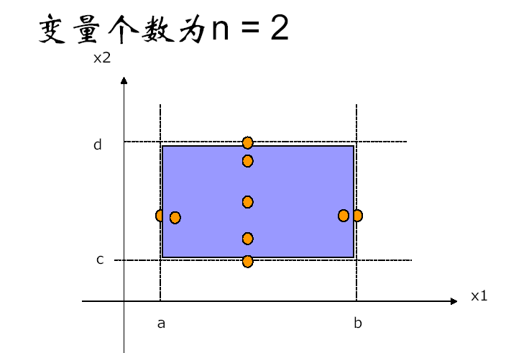
边界值组合1

Slide 54
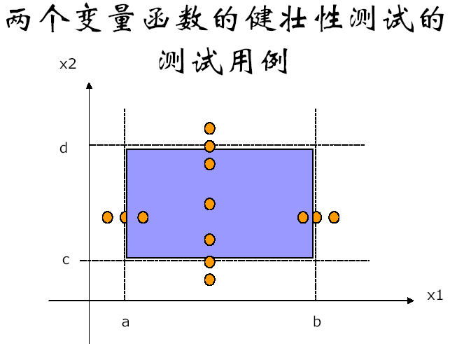
边界值组合2

Slide 55
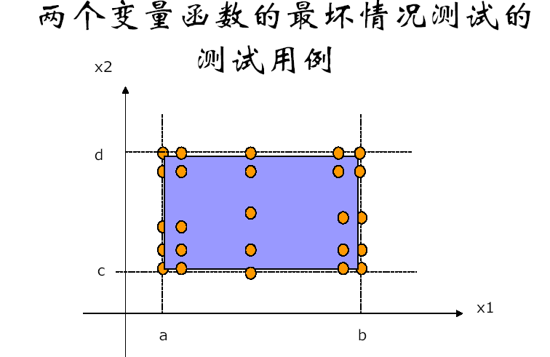
边界值组合3

Slide 56
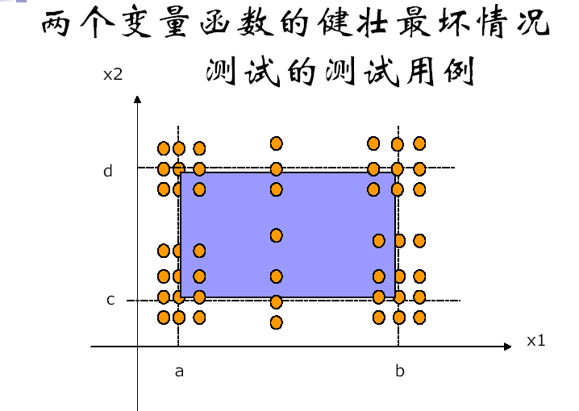
边界值组合4

Slide 57
三角形程序边界值分析
在三角形问题描述中，除了要求边长是整数外，没有给出其它的限制条件。在此，我们将三角形每边边长的取范围值设值为[1, 100] 。

Slide 58
NextDate程序边界值分析
在NextDate函数中，隐含规定了变量mouth和变量day的取值范围为1≤mouth≤12和1≤day≤31，并设定变量year的取值范围为1900≤year≤2000

Slide 59
Discussion

Slide 60
Example1
Correct border
OFF
ON
ON
Given border
Example for an open border: ><, < or >. Border outside the line

Slide 61
Example2
Correct border
OFF
ON
ON
Given border
OFF
Example for an closed border: “=“ predicate. Border on the line

Slide 62
Example 3
Correct border
OFF
ON
ON
Given border

Slide 63
Domain Testing
-revisit
Domain testing, as it is described here, requires that we know how the input partition the input space into input domains.
Thus, it is only possible to use it for small chunks of code.

Slide 64
Predicates
We will assume that all predicates are simple. This implies that they contain only one relational operator. Allowable operators are =, ><, >=, <=, < and >.
Predicates that are not simple can be split into two or more simple predicates.

Slide 65
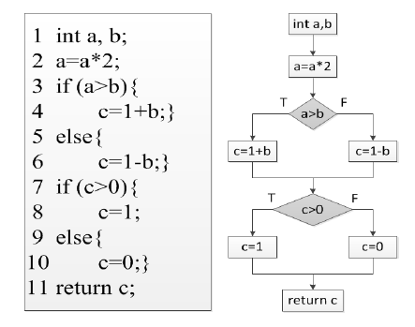
Example

Slide 66
Path Condition
Each path thorough a system is defined by a path condition – the conjunction of all predicates encountered along this path.
An input traverses a path if and only if the path condition is fulfilled.
The path condition defines a path domain, which is the set of all inputs that cause the path to be executed.

Slide 67
Example

Slide 68
Predicate Interpretation
The predicate interpretation of a branch statement is constructed similarly to path condition by skipping other branch statements.
Why to use Predicate Interpretation

Slide 69
Example

Slide 70
Path Domain
A path domain is surrounded by a boundary, consisting of one or more borders where each border corresponds to a predicate.
P1
P1 and P2: {S1, S3,S4}
P1 and not P2: {S1, S3, S5}
not P1 and P2: {S2, S3, S4}
not P1 and not P2: {S2, S3, S5}
S1
S2
S3
P2
S4
S5

Slide 71
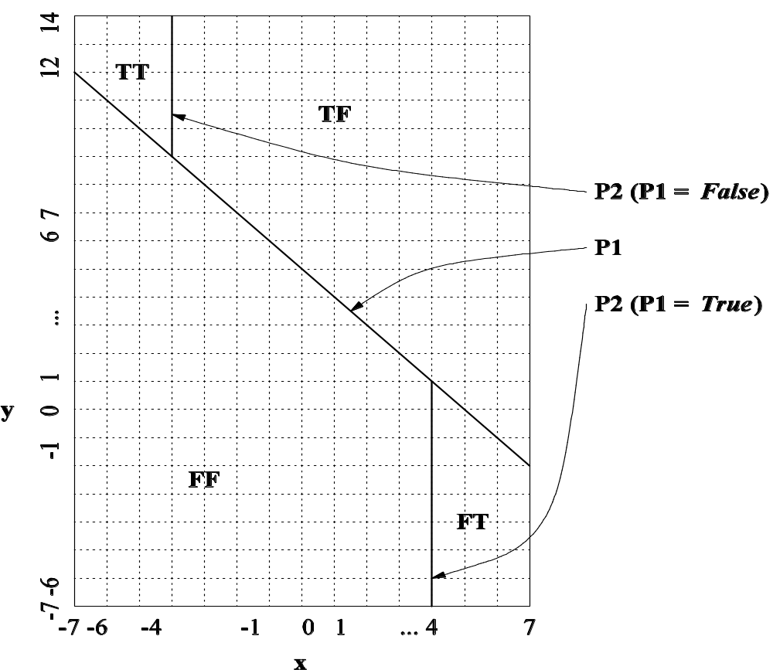
Input Domain Partition
Notes:
Handouts

Slide 72
Path Domain
P1
P1 and P2: {S1, S3,S4}
P1 and not P2: {S1, S3, S5}
not P1 and P2: {S2, S3, S4}
not P1 and not P2: {S2, S3, S5}
S1
S2
S3
P2
S4
S5

Slide 73
Symbolic Execution
The basic idea behind symbolic execution is to use symbolic values instead of concrete data as input.
Test data generation
  Construct path condition by symbolic execution
  Solve path condition by constrain solving
Dynamic symbolic execution

Slide 74
A Simple Algorithm
We can apply domain testing as follows:
Select a test case and run it. This will cause one path to be traversed.
Identify the borders of this path and test them with ON and OFF points
If the OFF point belongs to a new path then this path is selected for testing otherwise check another OFF point.
Terminate when no new path can be found

Slide 75
Domain Error
A domain error occurs if an input traverses the wrong path through the program.
We have no way to know the correct borders and there is no unique correct version of the program.
When domain error occurs along a path, it may be thought of as being caused by one of the given borders being different from the correct one.

Slide 76
BVA for Path Domain
A border is
Closed if defined by a predicate containing =, =< or >=. Closed borders belong to the path domain.
Open if defined by a predicate containing ><, > or >. Open borders do not belong to the path domain.

Slide 77

BVA for Path Domain
Note the difference between open and closed domains.
Closed: what is
on the line belongs
to the domain
Open: what is off the line
– below or above –
belongs to the domain
X
X
X

Slide 78

Q & A

